Slide 1
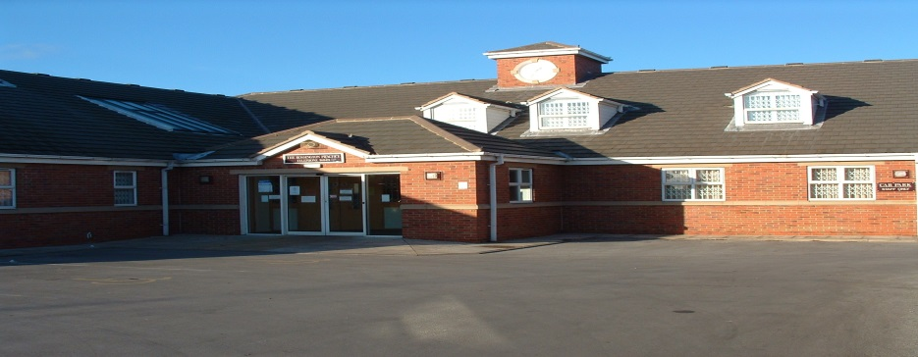
PATIENT PARTICIPATION GROUP
THE ROSSINGTON PRACTICE

Slide 2
INTRODUCTION
Patient participation is:
patients working with a practice to improve services;
varied to suit local needs; and
based on cooperation.
Patient participation is not:
a forum for complaints;
a doctors’ fan club; or
a time-consuming activity for practice staff.
Benefits
Good for patients
Patients will take more responsibility for their own health.
Patients will have a clearer understanding and knowledge of the practice and staff.
Patients will be consulted about their primary healthcare before decisions are made.
Patients will benefit from improved communications with staff.
Patients will have a forum to suggest positive ideas and voice their concerns.
Good for practice staff
Staff will be able to plan services jointly with patients and this should make services more effective.
Staff will be able to help patients with non-medical and social care issues.
Staff will be able to get help from patients in meeting targets and objectives.
Staff will have a forum to voice concerns, ideas and suggestions to patients.
Staff will build stronger links with their community.

Slide 3
WHAT’S HAPPENING CLINICAL
Shingles Vaccinations (70,71,72,78 & 79 years)
Men ACWY Vaccinations
New baby Men B vaccinations
Proactive Care
Minor Surgery
Minor Illness
New GPs

Slide 4
WHAT’S HAPPENING ADMIN
Electronic Prescribing Service (EPS)
Smear Clinics – after hours
Facebook Page keeping patients informed
Patient Access
Alzheimer’s/Dementia Awareness Summer Fayre

Slide 5
PATIENT ACCESS
Online Access Appointments
https://support.patient-access.co.uk/booking-appointments/how-do-i-book-an-appointment
Online Access Repeat Prescriptions
https://support.patient-access.co.uk/repeat-prescriptions
Online Access Brief Medical Summaries
Can I see my medical record in Patient Access?
Yes, if your practice have agreed to it. What you see and do on Patient Access is controlled by your practice and they decide:
There should be a medical record section on the Patient Access homepage once you've signed in, depending on what your practice have enabled you may be able to see your:
allergies
immunisations
conditions, e.g. asthma
test results
consultations
If you'd like to see more of your medical record than you currently can, speak to your practice about this.

Slide 6
WHAT’S HAPPENING PRACTICE
Medical Students
Foundation Doctors
Coming Soon – Student Nurses
Minor Surgery
Ladies Clinic
Fit For Work Scheme

Slide 7
Working win
Working Win can help address any issues impacting your well-being at work.
Working Win is here to support you in work, and if you’re off sick, in a way that’s right for you.
Working Win offers free, confidential and expert work-related health advice.
Referrals can be made via GP or employer

Slide 8
PATIENT PARTICIPATION GROUPS
Will be held every 6-8 weeks
Discuss practice issues
Undertake a patient survey and consult with results and action plans
Invitation to Doncaster wide PPGs
Be consulted on changes within the practice and the wider NHS Trust

Slide 9
INTERESTED?
Please leave your details and I will contact you with the date of the next meeting.
THANK YOU
Sheree Ridley, Practice Manager

